Slide 1
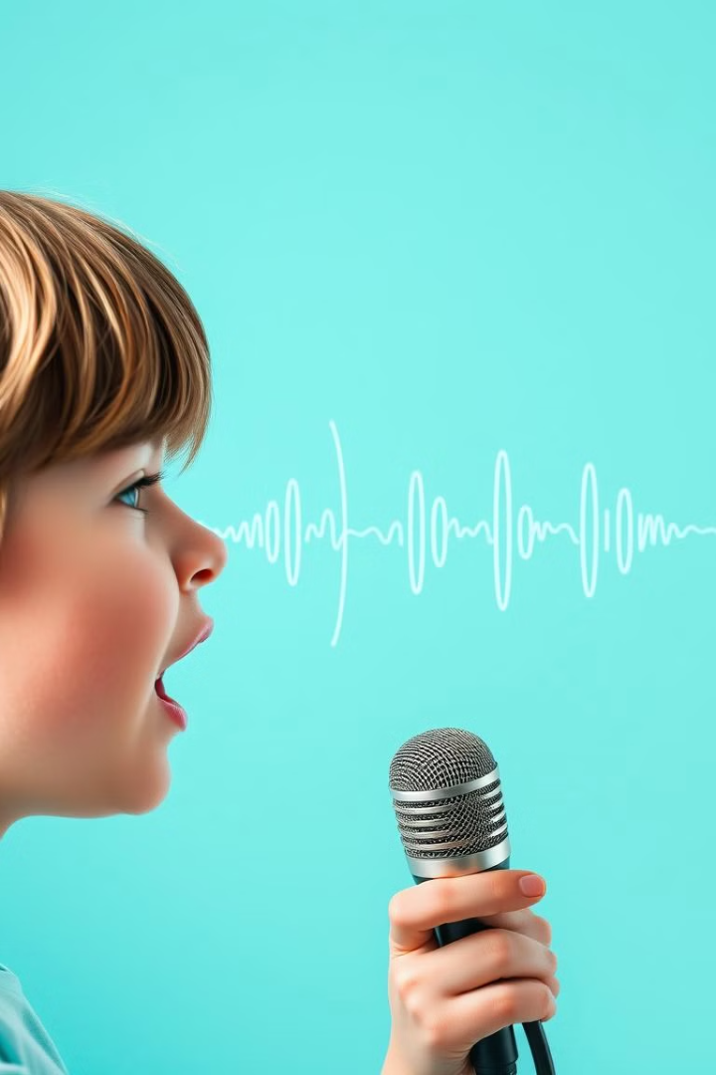
Leveraging Machine Learning for Stammering Speech Prediction and Correction
This project aims to utilize machine learning techniques to enhance speech interfaces for individuals who suffer from developmental stuttering. By leveraging advanced algorithms and datasets, the team is working to create a solution that can accurately detect and correct stammering in real-time, providing a more seamless and inclusive communication experience.

Slide 2
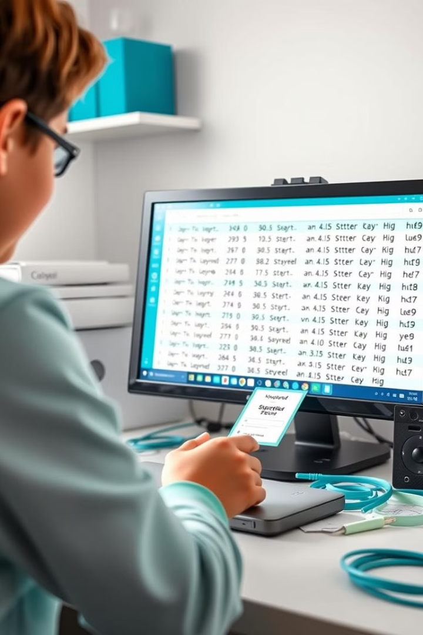
Data Engineering, Collection, and Labeling
Datasets
Our team is utilizing the UCLASS and SEP-28k datasets, which contain annotated stuttered speech data, providing a rich source for model fine-tuning.
Data Labeling
The dataset has been carefully labeled using a custom labeling function, ensuring accurate identification of stuttered and corrected speech.
Data Formatting
The data has been formatted into a custom dictionary structure, pairing the stuttered audio files with their corresponding transcriptions, ready for model training.
Data Augmentation
To enhance the dataset's robustness, our team has applied various audio augmentation techniques, including time stretching, pitch shifting, and additive noise, creating diverse variations for effective model training.

Slide 3
Model Selection and Configuration
Wav2Vec 2.0
Preliminary Testing
The Wav2Vec 2.0 model (facebook/wav2vec2-large-960h) has been selected for this project due to its outstanding performance in automatic speech recognition, achieving a Word Error Rate (WER) of approximately 1.9% and a Character Error Rate (CER) of 3.0% on the LibriSpeech dataset.
Preliminary testing of the Wav2Vec 2.0 model has shown promising results, with an F1-score of 0.94 in accurately transcribing general speech, indicating its suitability for fine-tuning to detect and correct stuttering.

Slide 4
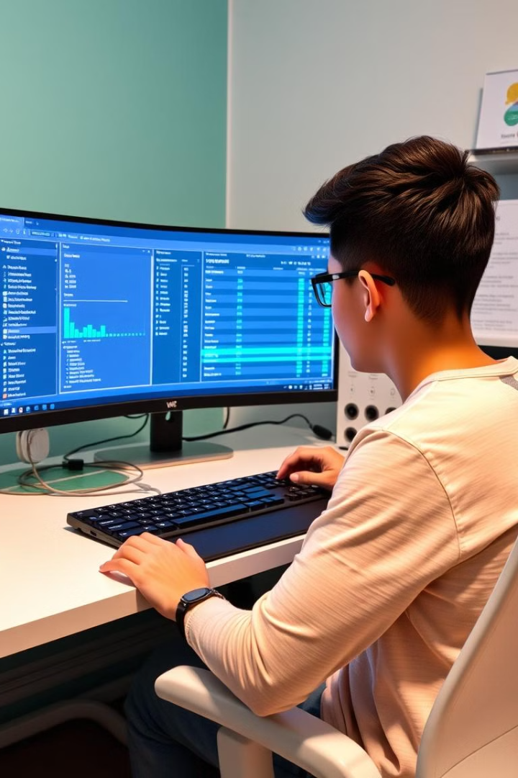
Fine-Tuning Strategy
1
Paired Data
Our fine-tuning strategy involves training the Wav2Vec 2.0 model on paired stuttered and corrected speech data, allowing the model to learn the mapping from disfluent to fluent text.
2
Model Adaptation
By fine-tuning the pre-trained Wav2Vec 2.0 model on the labeled stuttered speech data, the team aims to enhance the model's ability to detect and correct stammering in real-time speech.
3
Evaluation
The fine-tuned model will be thoroughly evaluated to ensure its effectiveness in accurately identifying and correcting stuttering, providing a seamless and inclusive speech interface for individuals with developmental speech disorders.

Slide 5

Datasets and References
1
UCLASS Dataset
The UCLASS dataset, containing annotated stuttered speech data, is a key resource for this project.
2
SEP-28 Dataset
The SEP-28 dataset, another source of annotated stuttered speech, is also being utilized in this project.
3
Research References
The team has referenced relevant research papers and resources to guide the development of this project.

Slide 6
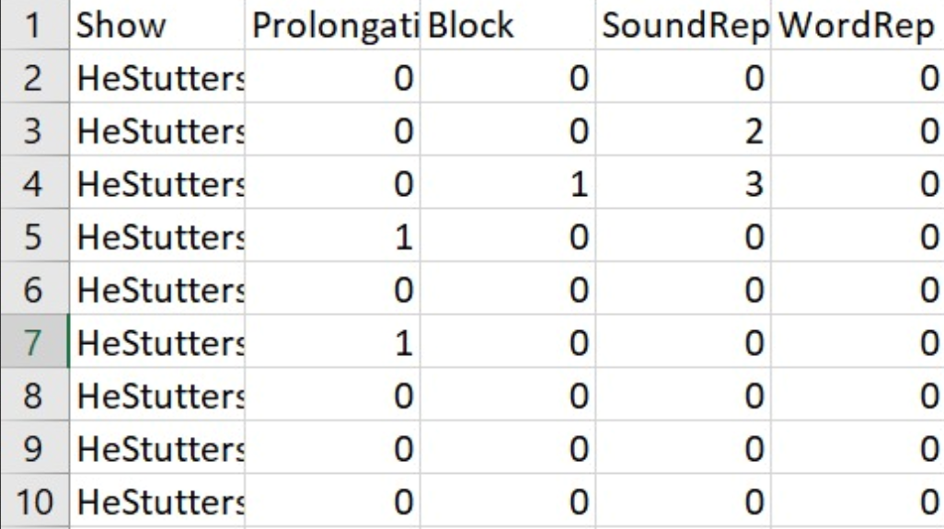
Extracted Features from Sep28K

Slide 7
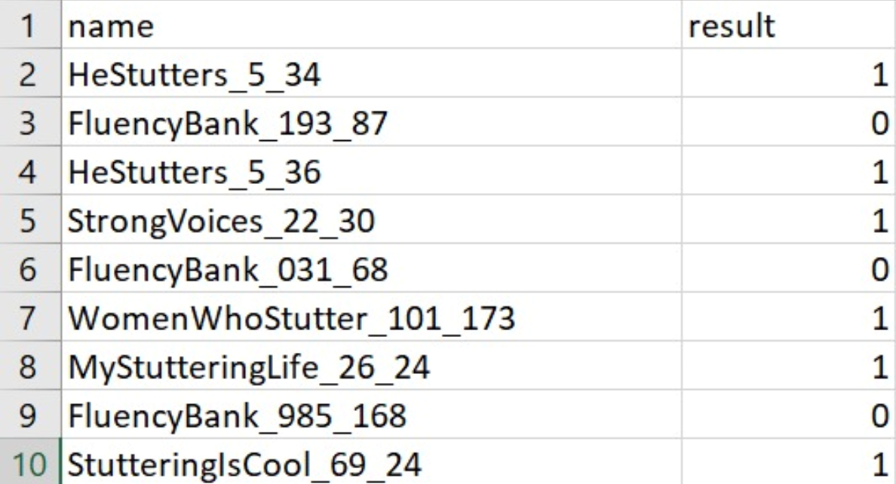
Dataset used for Stuttering Events Detection

Slide 8
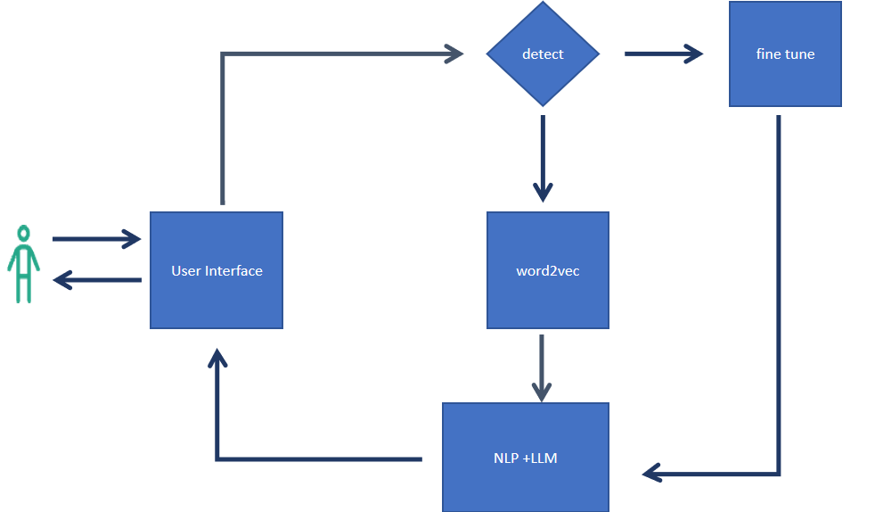
Model Flow Diagram
fine tuned model
YES
NO
INPUT
Transcription
OUTPUT
Transcription
Corrected Text
NLP + LLM

Slide 9
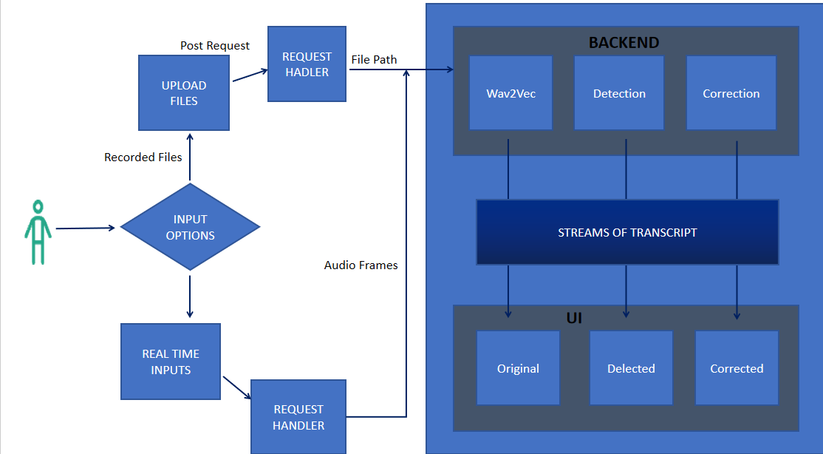
Flow Diagram Of Model Deployment

Slide 10
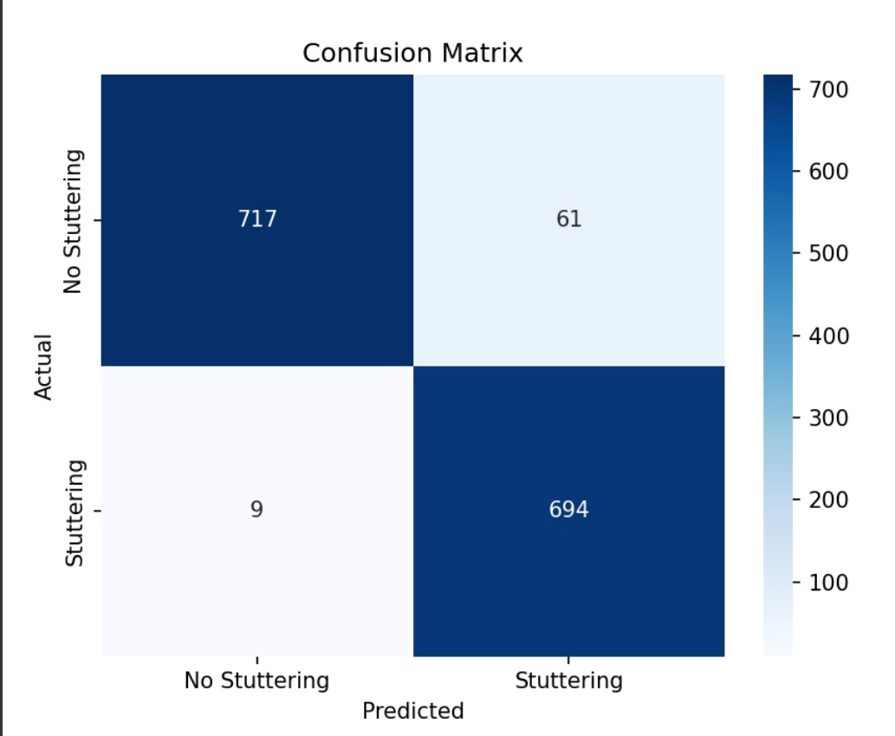
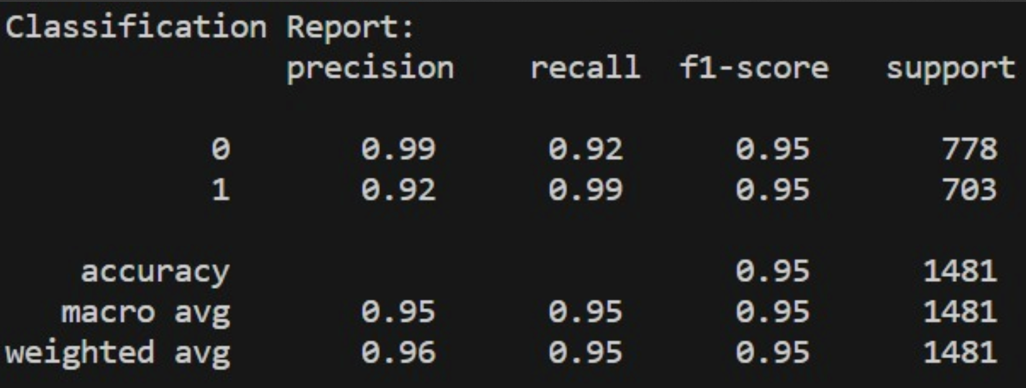
Performance of Sluttering Detection Model performance

Slide 11
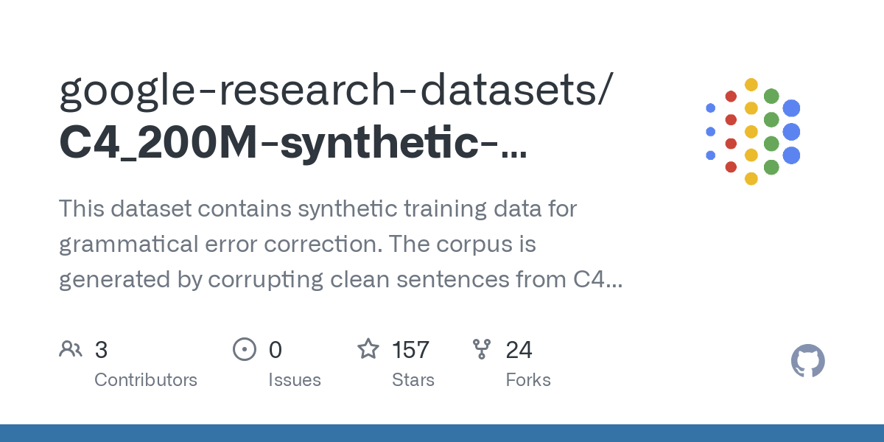
Data Set used for tranning NLP Model
The C4 200M Grammar Error Correction dataset is a large-scale synthetic dataset designed for Grammatical Error Correction (GEC) tasks.
It was generated as part of research into improving GEC models and leverages the Colossal Clean Crawled Corpus (C4), which is a dataset derived from web data
Grammar Error Correction synthetic dataset consist of 185 million sentence pairs.
Clean sentences were sourced from the C4 dataset, which is derived from web content
Grammatical errors were introduced
Fined tuned T5 model

Slide 12
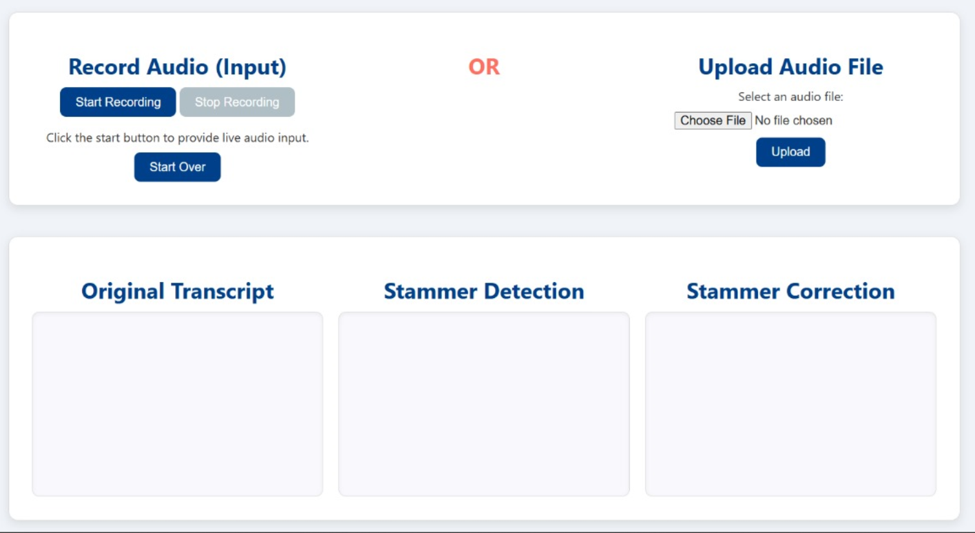
User Interface For The Deployed Model

Slide 13

BACKEND
Post Request
REQUEST HADLER
UPLOAD FILES
File Path
Wav2Vec
Detection
Correction
Recorded Files
INPUT OPTIONS
STREAMS OF TRANSCRIPT
Audio Frames
UI
REAL TIME INPUTS
Original
Delected
Corrected
REQUEST HANDLER

Slide 14


Project Team
Priyanshu Shukla
2024CSM1016
Shubham Jha
2024CSM1019
Ajayvir Singh Sandhu
2024EEM1017
Harasees Kaur
2024CSZ0001

Slide 15
Conclusion and Future Scopes
We were able to successfully build and deploy the model that detects the stuttering with 95% accuracy and F1 score of 0.95.
Future Scopes
The model currently gives text as the output but in future we would try the output to be in voice
Deployment on cloud
Making it scalable for multiple user

Slide 16
INDIVIDUAL CONTRIBUTIONS
Ajayvir singh Sandhu :- ML Model Development
Priyanshu Shukla :- Backend and Deployment
Shubham Jha :- NLP and Frontend Interface
Harasees Kaur :- Data Preprocessing and Feature Extraction

Slide 17
THANK YOU

